Slide 1
Welcome Parents!

Slide 2
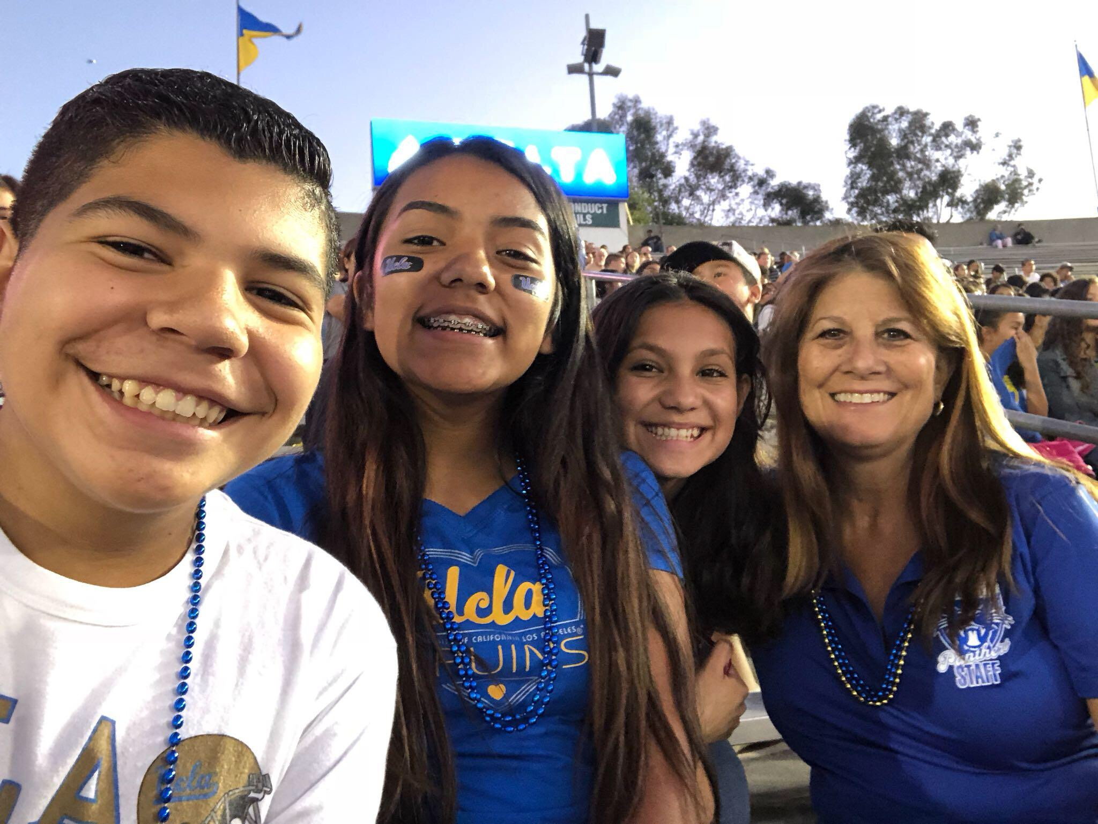
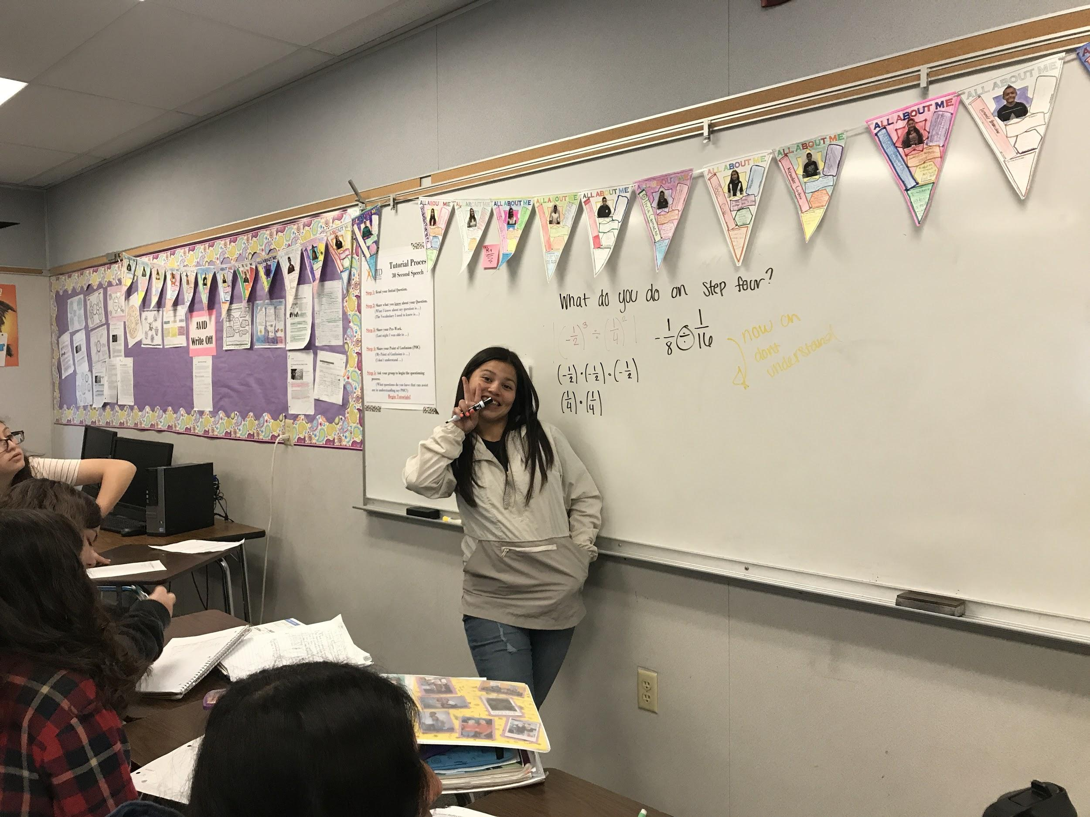
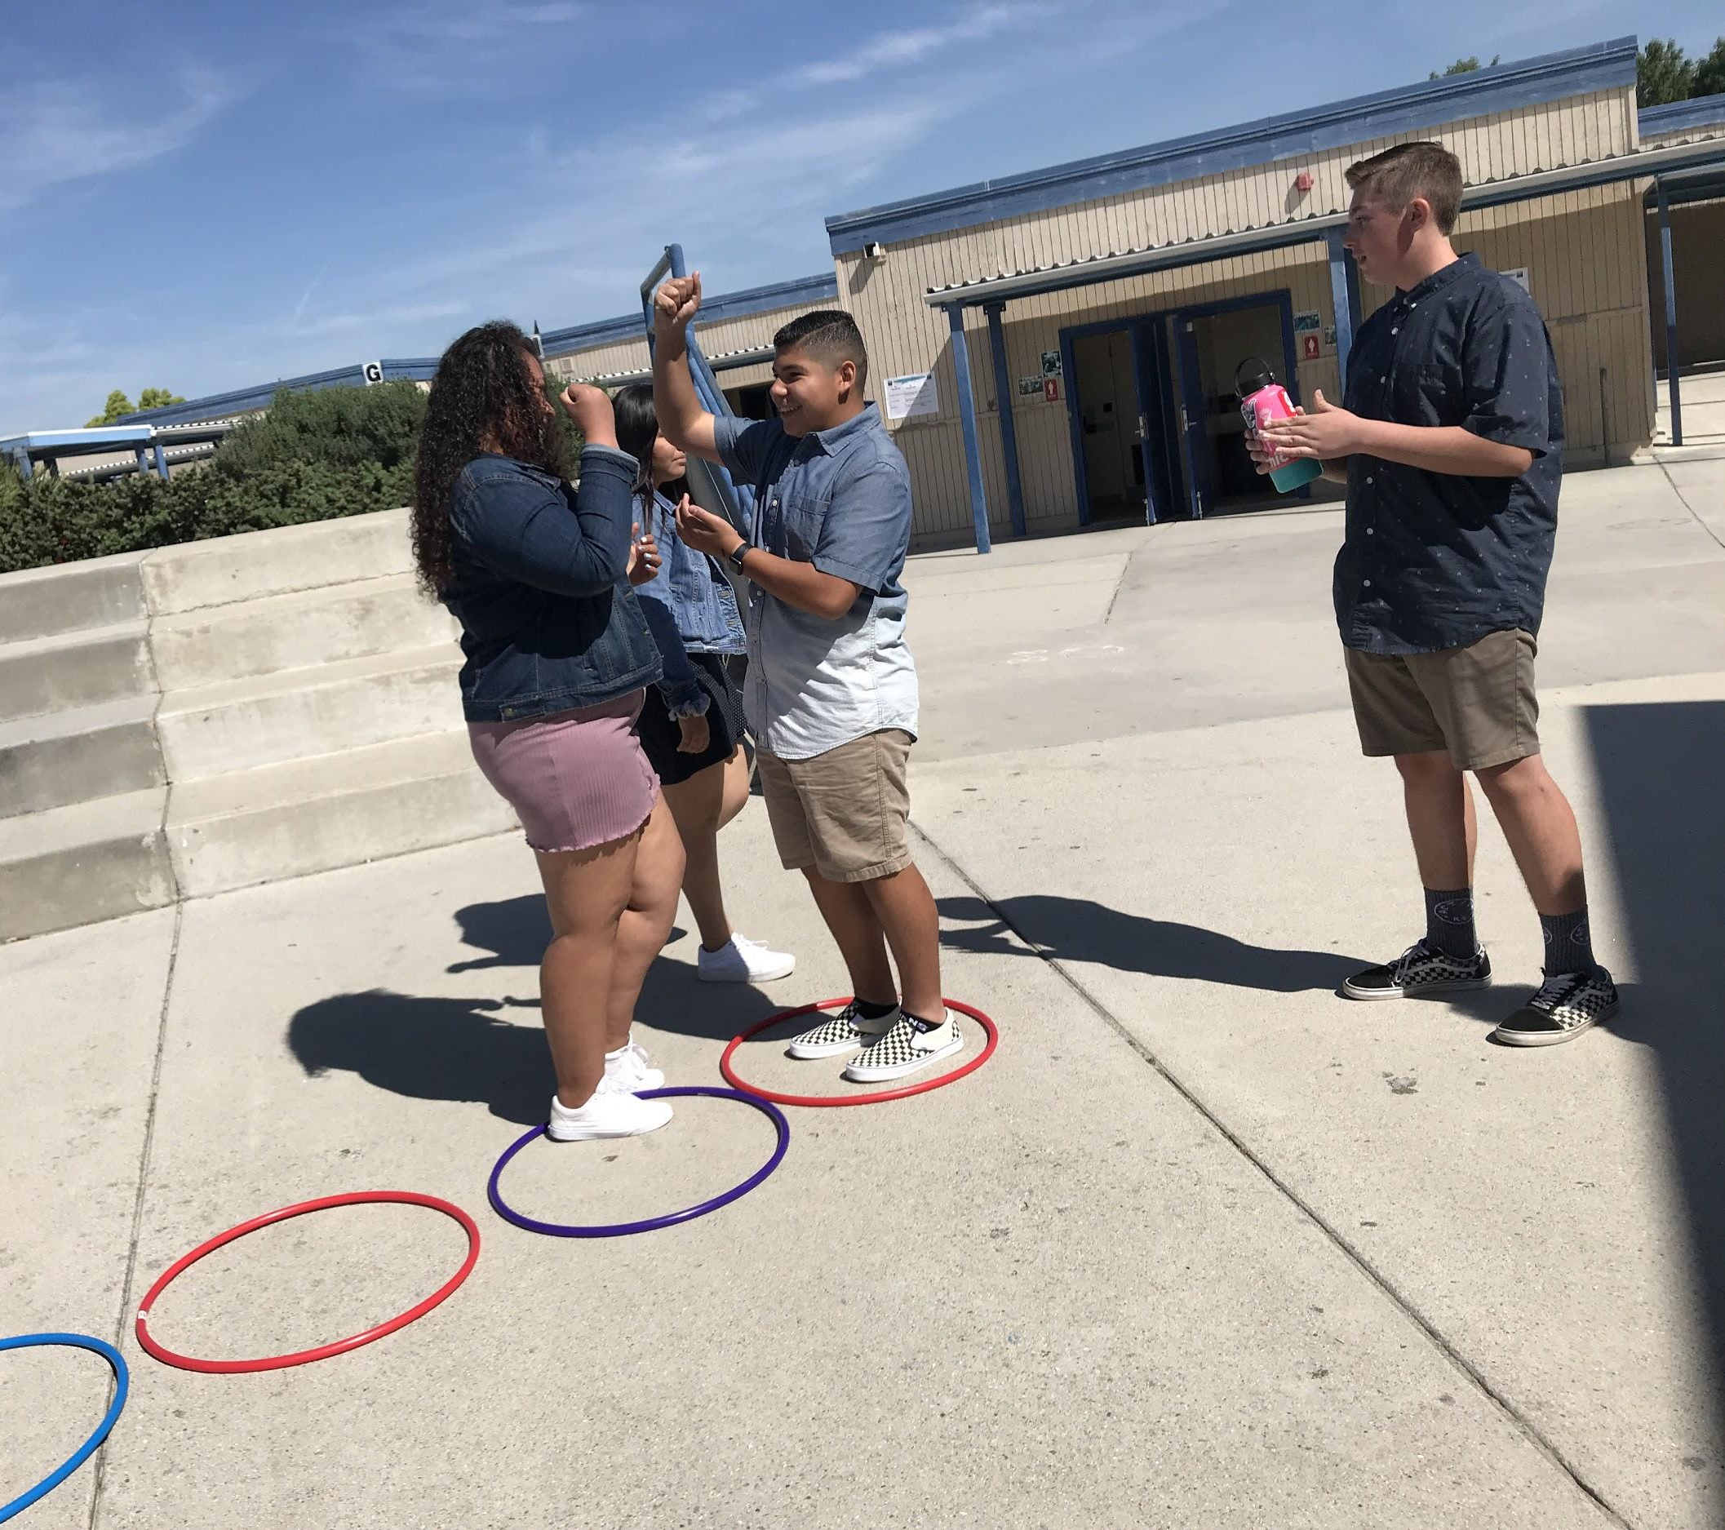
Advancement Via Individual Determination
Lisa Bader/AVID Coordinator

Slide 3
AVID’s mission
AVID's mission is to close the achievement gap by preparing all students for college readiness and success in a global society.

Slide 4
AVID Facts
AVID was founded by Mary Catherine Swanson in 1980 at Clairemont High School in the San Diego Unified School District.
AVID identifies students in the middle who have been the least served by the school in grades 6-12 and prepares them for four-year college entry.
AVID serves over 700,000 students in 46 states, and 16 countries.
Over 90% of AVID’s graduates enroll in a four-year college.

Slide 5

What is AVID?
  A structured college preparatory system working directly with schools and districts
  A direct support structure for first-generation college goers, grades 6-12.
  A schoolwide approach to curriculum and rigor
Notes:
THIS SEEMS TO FALL INTO THE CATEGORY OF WHAT WE DO ((vs. what we ARE): A professional development program providing training throughout the world

Slide 6
What is AVID?
A non-profit, college readiness system
A support structure for typically low-income, underserved students
For elementary through secondary grade levels
A schoolwide approach to rigorous curriculum
Notes:
Adopted by approximately 4,800 schools in 48 states and 16 countries/territories, reaching more than 425,000 students
More than 30 years, AVID has become one of the most successful college-preparatory programs for low-income, underserved students
A direct support structure for first-generation college goers, grades 4-12
A schoolwide approach to curriculum and rigor adopted by approximately
A professional development program providing training throughout the U.S.

Slide 7
What AVID is NOT!
AVID is not a remedial program.
AVID is not a free ride.
AVID is not a college outreach program.
AVID is not an at-risk program.

Slide 8
The AVID Elective student profile
Has academic potential:
  Average to high test scores
  2.0-3.5 GPA
  College potential with support
  Desire and determination

Slide 9

The AVID Elective student profile
Meets one or more of the following criteria:
  First to attend college
  Historically underserved in four-year colleges
  Low income
  Special circumstances
Notes:
Meets one or more of the following criteria:

Slide 10

WICOR
Writing
  Writing process (prewrite to final draft)
  Respond, revise
  Edit, final draft
  Cornell notes
  Quickwrites
  Learning logs, journals
Notes:
Cornell Notes for class lectures and for textbook

Slide 11

WICOR
Inquiry
  Skilled questioning
  Socratic Seminars
  Quickwrites/discussions
  Critical-thinking activities
  Writing questions
  Open-minded activities

Slide 12

WICOR
Collaboration
  Group projects
  Response/edit/revision groups
  Collaboration activities
  Tutorials
  Study groups
  Read-arounds
  Team building

Slide 13

WICOR
Organization
Tools
Binders
Calendars, planners, agendas
Graphic organizers
Methods
Focused note-taking system
Tutorials, study groups
Project planning
Notes:
Organization is:
Managing materials and practicing methodical study habits
Planning and prioritizing school, work, and social tasks
Engaging in mental preparation and goal-setting
Strategically and intentionally taking responsibility for one’s own learning
Students who organize:
1. Develop and use processes, procedures and tools to study effectively.
2. Manage their time through prioritizing and goal-setting
3. Are prepared for courses, participate during instruction and interact with instructors
4. Self-direct, self-evaluate, self-monitor, self-advocate

Slide 14

WICOR
Reading
  SQ5R (Survey, Question, Read, Record, Recite, Review, Reflect)
  KWL (What I Know; What to Learn; Learned)
  Reciprocal teaching
  Text structure
  Critical reading

Slide 15
A sample week in the AVID Elective
Sample Daily Schedule
Monday | Tuesday | Wednesday | Thursday | Friday
AVID Curriculum | Tutorials | AVID Curriculum | Tutorials | Binder Evaluation Field Trips Media Center Speakers Motivational Activities
Curriculum:
Writing
College and Careers
Strategies for Success
Critical Reading
Tutorials:
Collaborative Study Groups
Writing Groups
Socratic Seminars

Slide 16
What is academic rigor?
Rigor is the goal of helping students develop the capacity to understand content that is complex, ambiguous, provocative, and personally or emotionally challenging.
Taking rigorous courses opens doors!
Source: Teaching What Matters Most; Standards and Strategies for Raising Student Achievement, by Strong, Silver and Perini, ASCD, 2001.
Notes:
Taking rigorous courses opens doors!

Slide 17

Meeting the challenge
    Develop as readers and writers
    Develop deep content knowledge
    Know content specific strategies for reading, writing, thinking, and talking
    Develop habits, skills, and behaviors to use knowledge and skills
Notes:
To help all students do rigorous work and meet or exceed high standards in each content area, we must help students:

Slide 18
Why does AVID work?
Places AVID students in rigorous curriculum and gives them the support to achieve
Provides a team of students for positive
peer identification
Redefines the teacher’s role as that of
student advocate

Slide 19
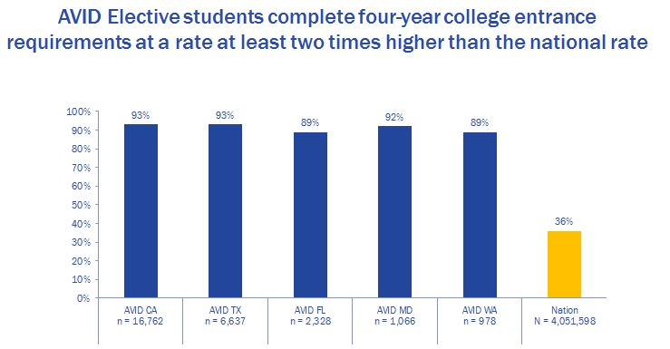
Completing college-entrance requirements
AVID students complete four-year college entrance requirements at a rate of almost 3 times higher than
the national rate.

Slide 20
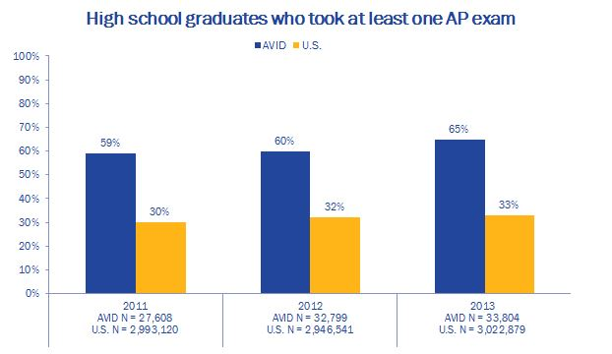
Students taking AP Exams

Slide 21
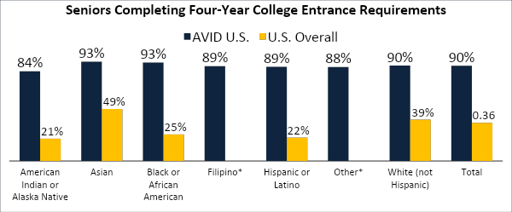
AVID closes the achievement gap
All racial groups complete four-year college entrance requirements at a rate of 84% or higher
AVID Center. AVID Senior Data Collection. Study of 27,891 AVID Seniors, [Electronic Database]. (2010 - 2011).
Manhattan Institute, Education Working Paper 3. 2003. Greene, J.P., Forster, G. "Public High School Graduation and College Readiness Rates in the U.S.”
*(Filipino and Other not classified in Manhattan Institute study.)
National data represents the most current comprehensive data available

Slide 22
AVID Requirements
I agree to take notes in all my core classes as required in AVID.
I agree to keep my binder organized as required by AVID.
I agree to participate fully in tutorials as required by AVID.
I agree to complete all my assignments in all classes including AVID.
I agree to participate in field trips, college visitation and other AVID activities.
I agree to keep my parents fully informed of AVID program activities.
I agree to maintain a minimum of a 2.0 GPA throughout the entire year.
I agree to maintain satisfactory citizenship and work habits in all classes and off campus throughout the entire year.
I agree to keep a positive attitude and be enthusiastic about preparing for college.
I agree to give back to my community by completing at least 1 hour of community service per Trimester.

Slide 23
Contact Information
Lisa Bader- AVID Coordinator/Teacher
  Email: lisa_bader@chino.k12.ca.us

Slide 24
Thank you for Coming!

